Slide 1


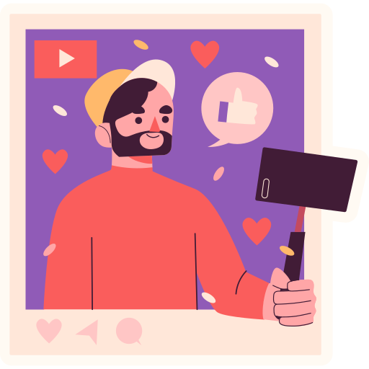


SOSIAL media
FOR ALL

Slide 2

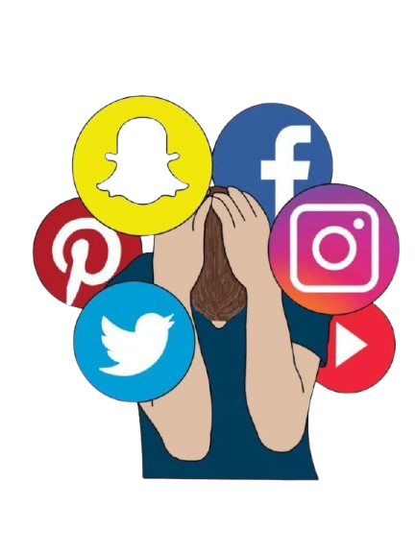






Social media refers to internet-based platforms that allow users to create, share, and interact with content (text, images, videos) in the form of online social networks.
What is social media?
Two-way interaction between users.
Content creation by users.
Connection between individuals or groups.
Easy access through mobile devices or computers

Slide 3

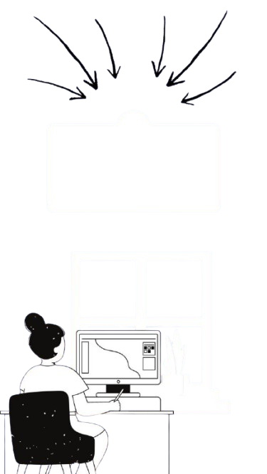

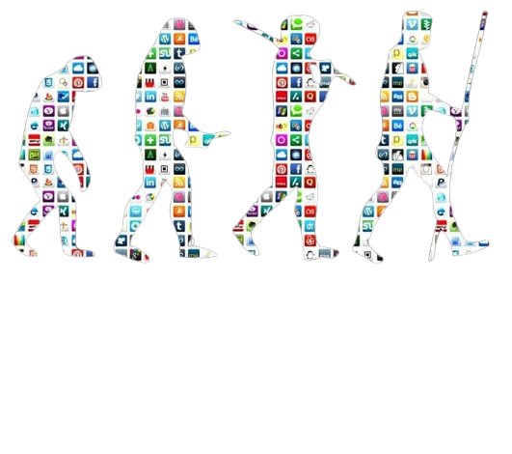
EVOLUTION OF SOCIAL MEDIA
https://vt.tiktok.com/ZSj373PrH/
Timeline:
Early 2000s: Rise of MySpace and Facebook.
2010s: Mobile apps like Instagram and Snapchat.
2020s: Dominance of TikTok and video content.
Technological Advancements: AI algorithms, live streaming, and augmented reality.
Social Trends: From blogs to short-form video.

Slide 4











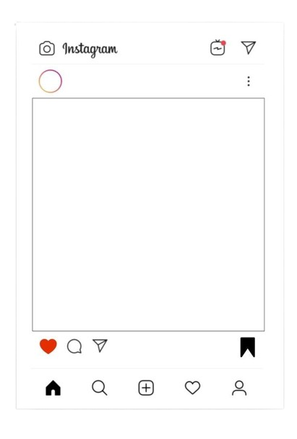

B E N E F I T S
Communication and Connection
Learning Opportunities
Marketing and Business
It facilitates communication with friends, family, colleagues, and new people worldwide.
Many platforms offer access to courses, webinars, and educational materials.
Social media is used by businesses to promote products, services, and expand their market reach.

Slide 5



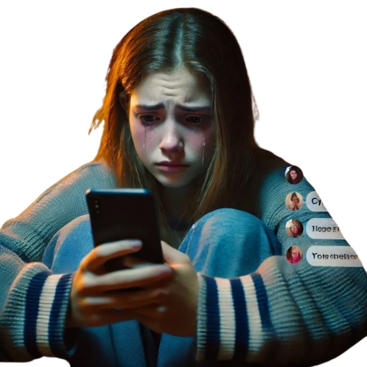

N E G A T I V E S I D E O F M E D I A S O C I A L
. Mental Health Issues
Impact on Self-Esteem: Constant exposure to idealized images and lifestyles can lead to feelings of inadequacy, low self-esteem, and body image issues.
Addiction: Excessive use can lead to social media addiction, contributing to anxiety, depression, and sleep problems, especially in younger users.
Impact on Children and TeensEarly exposure to social media can disrupt emotional development, increase exposure to inappropriate content, and lead to academic distractions.
Spread of Misinformation
Social media platforms have become breeding grounds for fake news, conspiracy theories, and misinformation, influencing public opinion and causing confusion during crises (e.g., elections, pandemics).
https://youtu.be/XF8Ystpf9v4?si=CJOnqxUzD_rYLIgR

Slide 6



FUTURE OF
1. User Trends
Authenticity: Increased demand for genuine and transparent content.
Privacy-Centric Platforms: Platforms prioritizing user data security and anonymity.
Niche Communities: Growth of platforms tailored to specific interests and hobbies.
Short-Form Content: Continued popularity of TikTok-style videos and stories.
2.Technological Innovations: AI, VR/AR experiences, and the metaverse.
User Trends: Focus on authenticity, privacy, and niche communities.
Regulation and Ethics: Striking a balance between freedom and accountability.
Sustainability: Reducing the carbon footprint of digital activities.
3. Business Opportunities
Social Commerce Expansion: Seamless shopping experiences directly within apps.
Interactive Advertising: AR ads and AI-driven campaigns.
Creator Economy Growth: More tools and revenue options for content creators.

Slide 7



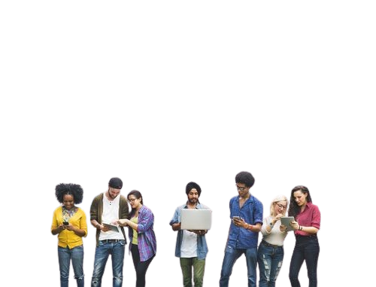
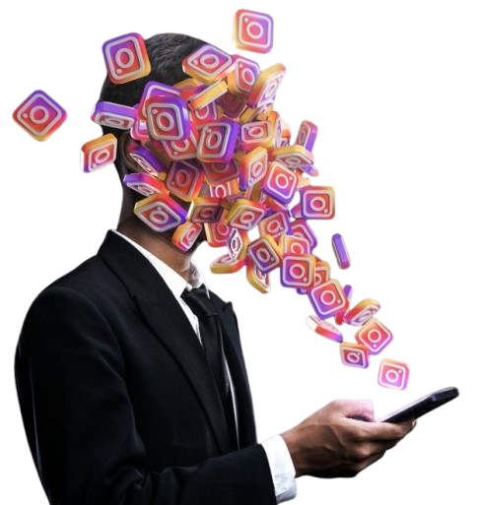
U S E S O F S O C I A L M E D I A
Business and Marketing
Promote brands and products through ads and posts.
Engage with customers and gather feedback.
Build online stores and enable social commerce.
Entertainment
Watch videos, stream music, and play games.
Follow celebrities, influencers, and trending content.
Discover and share memes, GIFs, and viral content.
Personal Branding and Creativity
Showcase talents and skills to a global audience.
Build a personal brand as an influencer or content creator.
Share art, photography, writing, and other creative works.

Slide 8


